Slide 1
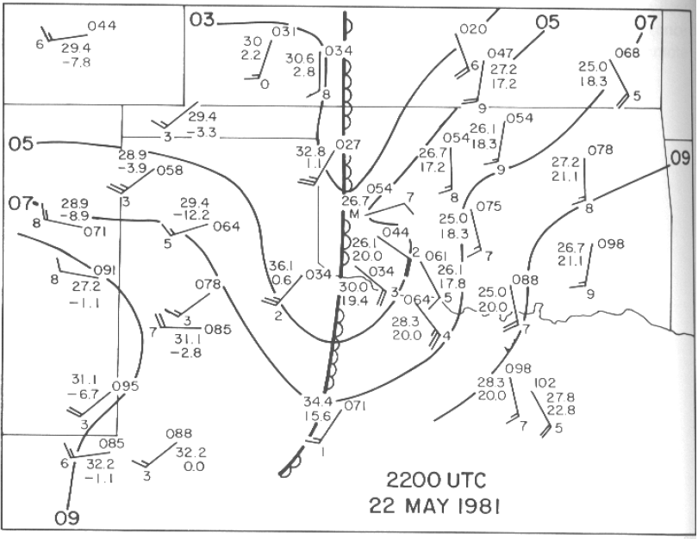
Dryline Overview
Contours: sea-level pressure every 2 hPa
Station model: T (°C), T_{d} (°C), p (hPa, leading 1 omitted), wind (barbs in kt)
typical symbolization; usually colored dark yellow to light brown
Reproduced from Synoptic-Dynamic Meteorology in Mid-Latitudes (Vol. II) by H. Bluestein, their Fig. 2.38.

Slide 2
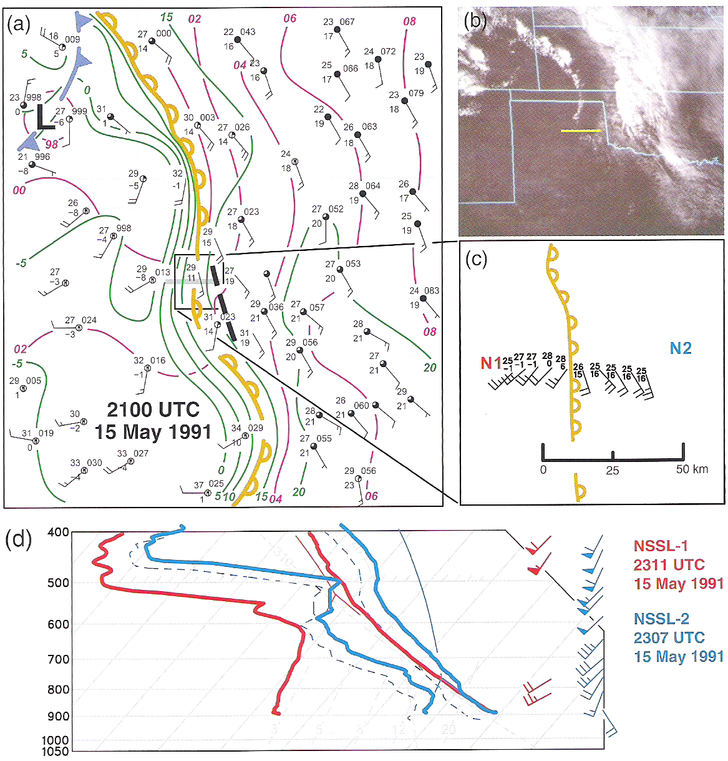
Dryline Overview
deep mixed layer
Reproduced from Mesoscale Meteorology in Mid-Latitudes, their Fig. 5.14.

Slide 3
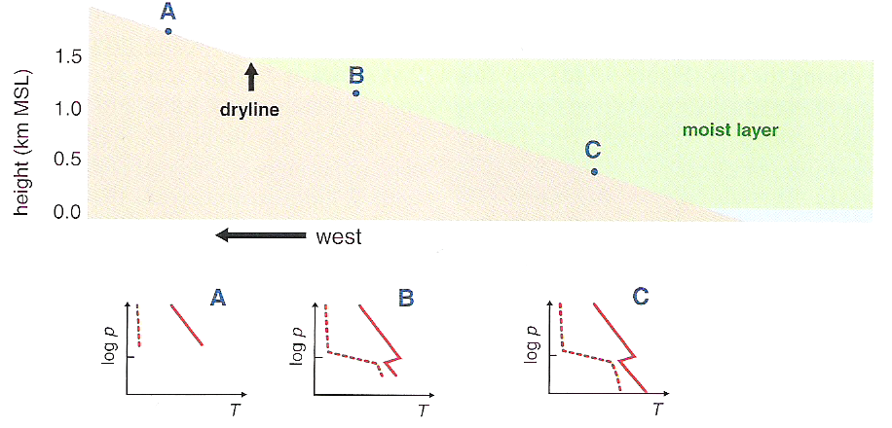
Dryline Vertical Structure
elevated mixed layer
Reproduced from Mesoscale Meteorology in Mid-Latitudes, their Fig. 5.16.

Slide 4
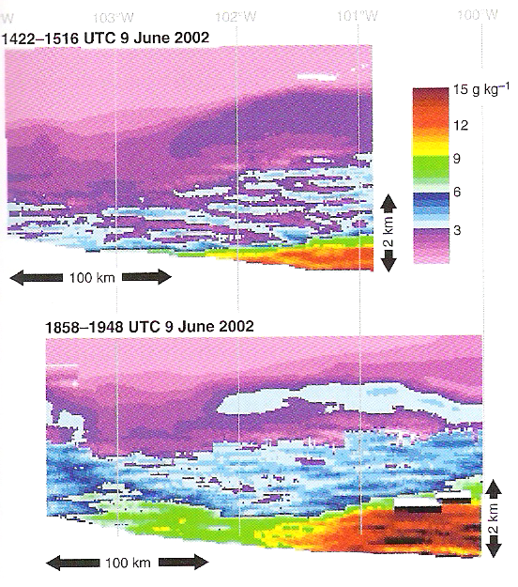
Dryline Vertical Structure
Reproduced from Mesoscale Meteorology in Mid-Latitudes, their Fig. 5.17.

Slide 5
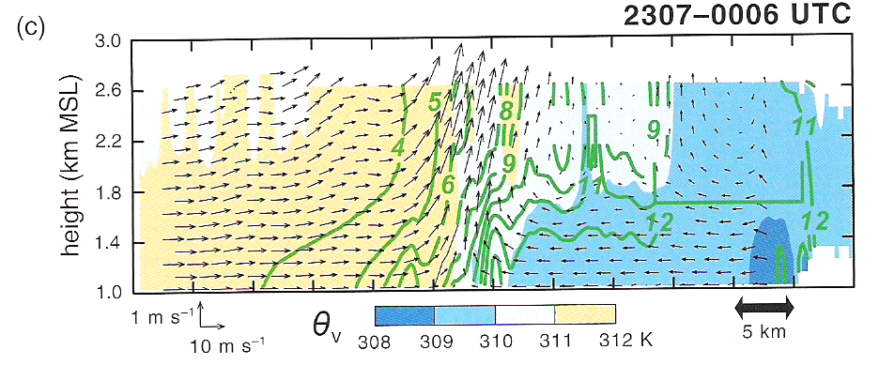
Dryline Vertical Structure
westerly flow/momentum mixed to surface, fairly uniform with height
W
C
L
H
Reproduced from Mesoscale Meteorology in Mid-Latitudes, their Fig. 5.18c.

Slide 6
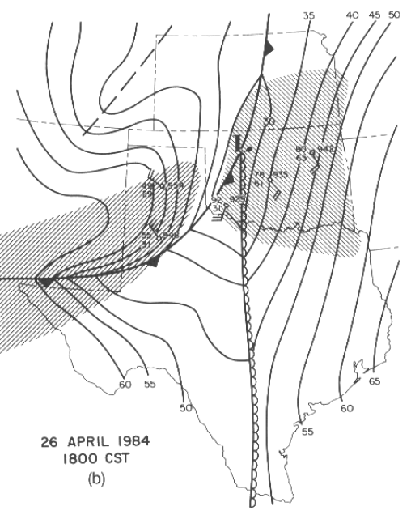
Dryline and Triple Points
triple point
H
Reproduced from Synoptic-Dynamic Meteorology in Mid-Latitudes (Vol. II) by H. Bluestein, their Fig. 2.39b.

Slide 7
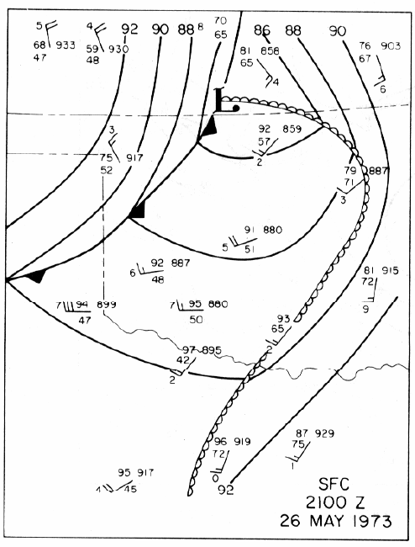
Dryline Bulges
Note: bulge need not be this pronounced or on this large of scale.
Reproduced from Mesoscale Meteorology by P. Ray (ed.), their Fig. 23.13.

Slide 8
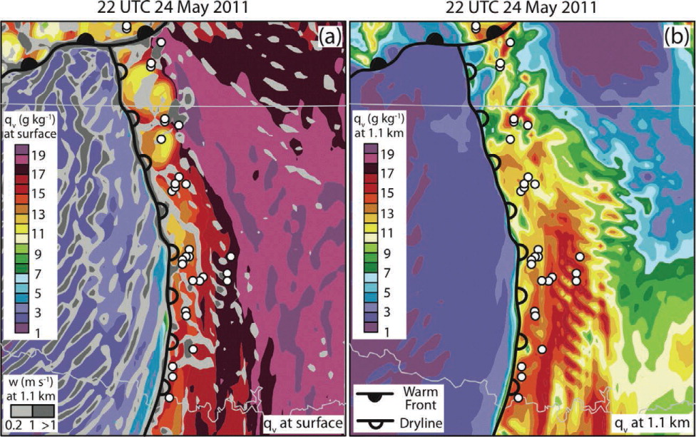
Convection Initiation
Reproduced from Kain et al. (2013, Bull. Amer. Meteor. Soc.), their Fig. 5.

Slide 9
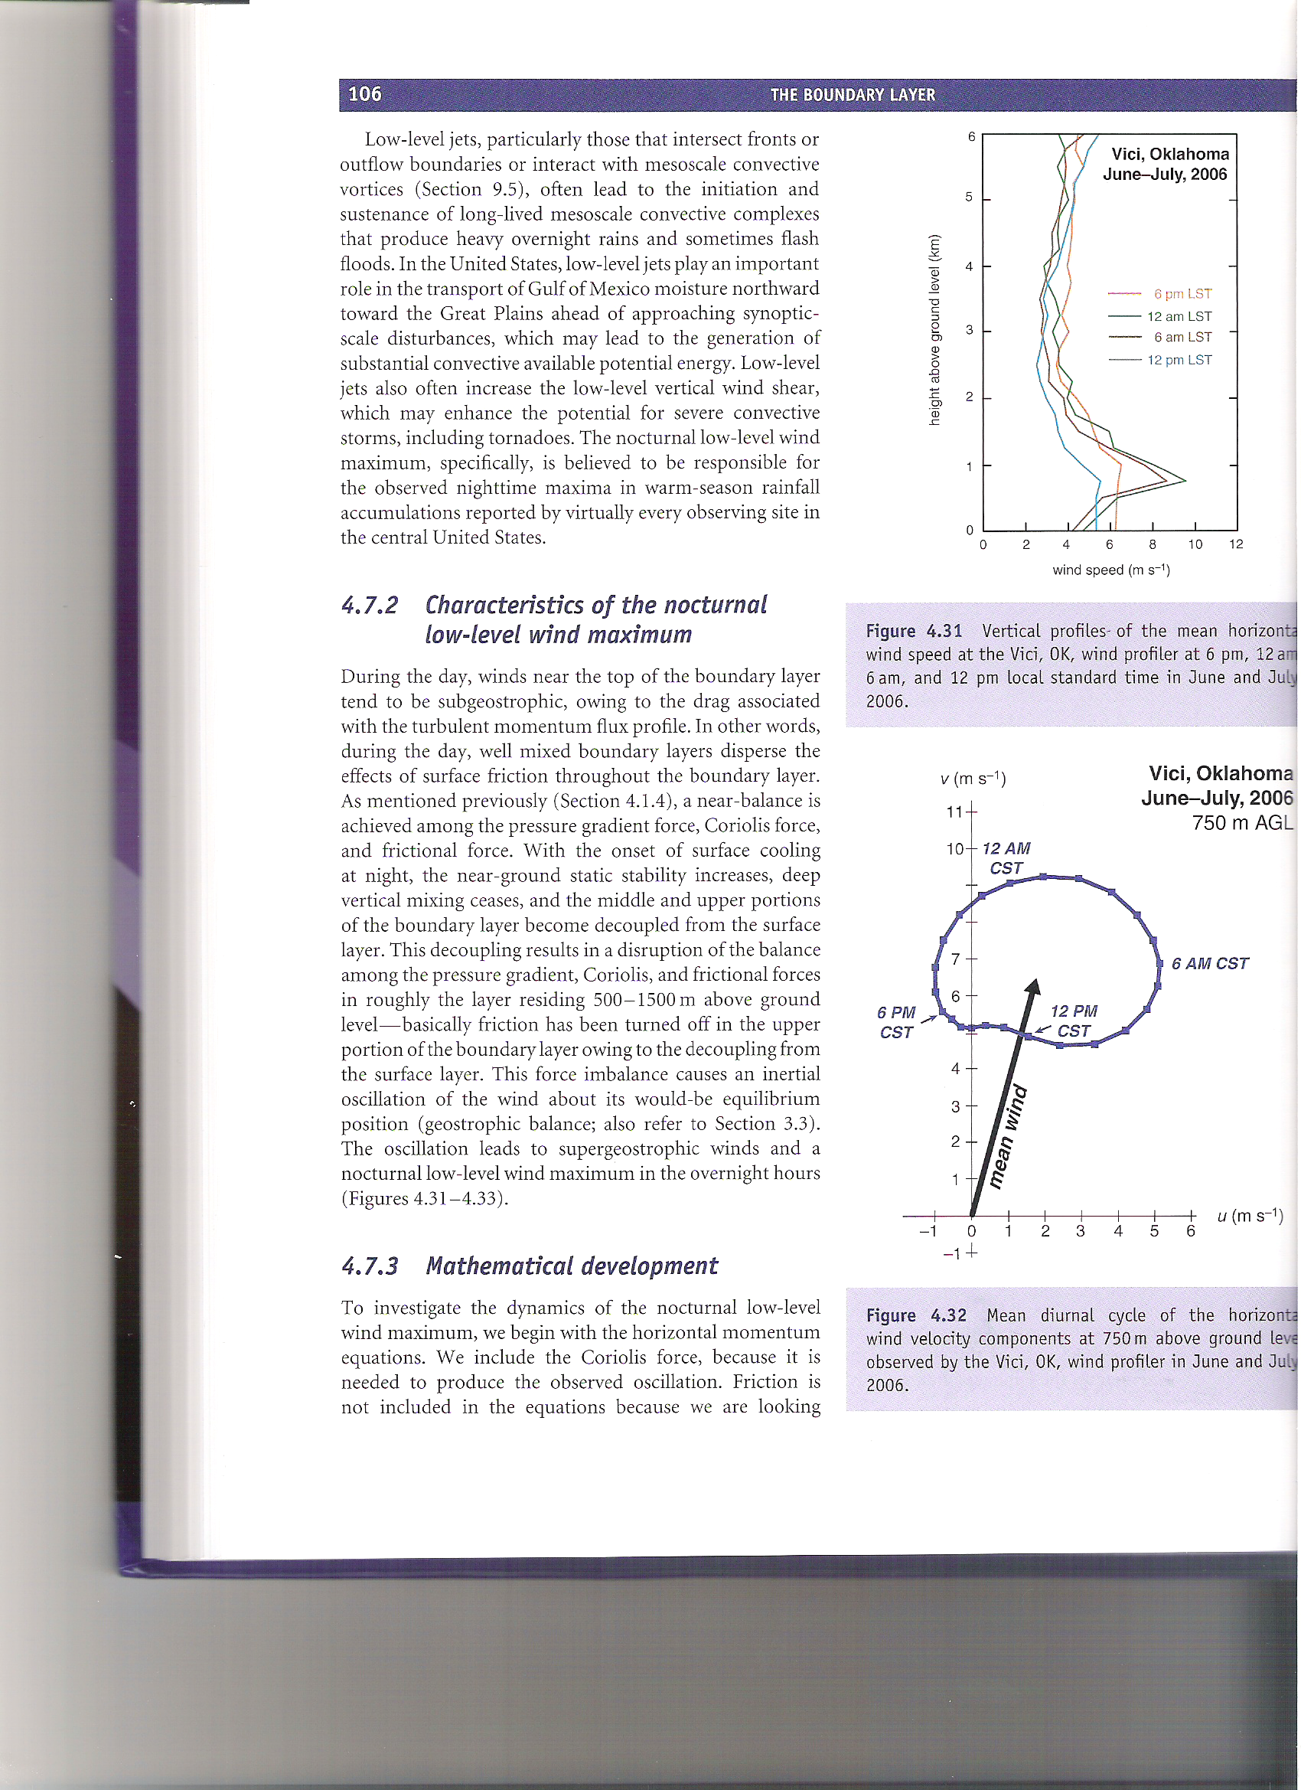
Nocturnal Low-Level Wind Maxima
Vectors from origin to blue dot = full wind
Mean wind can be viewed as the geostrophic wind
supergeostrophic
subgeostrophic
Reproduced from Mesoscale Meteorology in Mid-Latitudes, their Figs. 4.31-4.32.

Slide 10
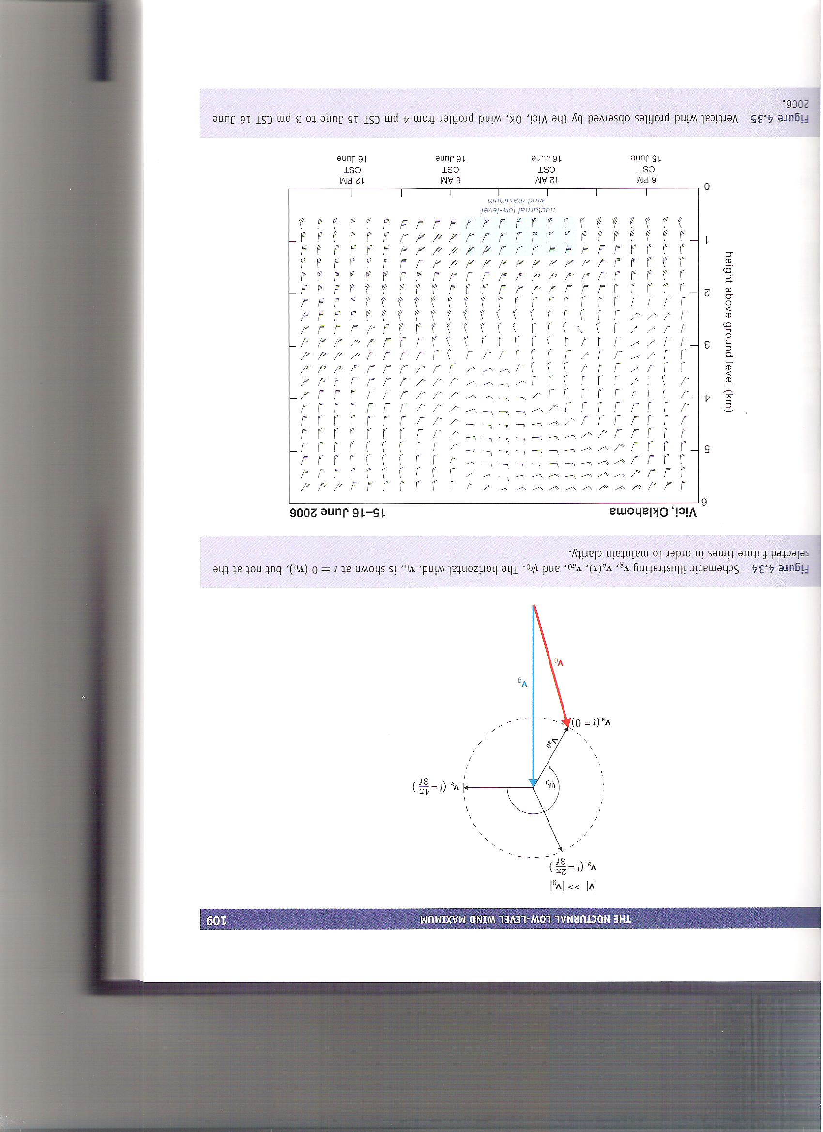
Nocturnal Low-Level Wind Maxima
Reproduced from Mesoscale Meteorology in Mid-Latitudes, their Fig. 4.35.

Slide 11
Inertial Oscillations
At t = t₀, ft = 0 and u_{ag} and v_{ag} are simply given by the projection of v_{ag0}.
As time progresses, the angle ψ₀-ft changes. This changes u_{ag} and v_{ag}, which changes the full wind (for constant geostrophic wind).
After one full rotation (t = 2π/f), we return to the initial situation.
v_{t+Δt}
v_{ag(t+Δt)}
ψ₀-ft
Reproduced from Mesoscale Meteorology in Mid-Latitudes, their Fig. 4.34.

Slide 12
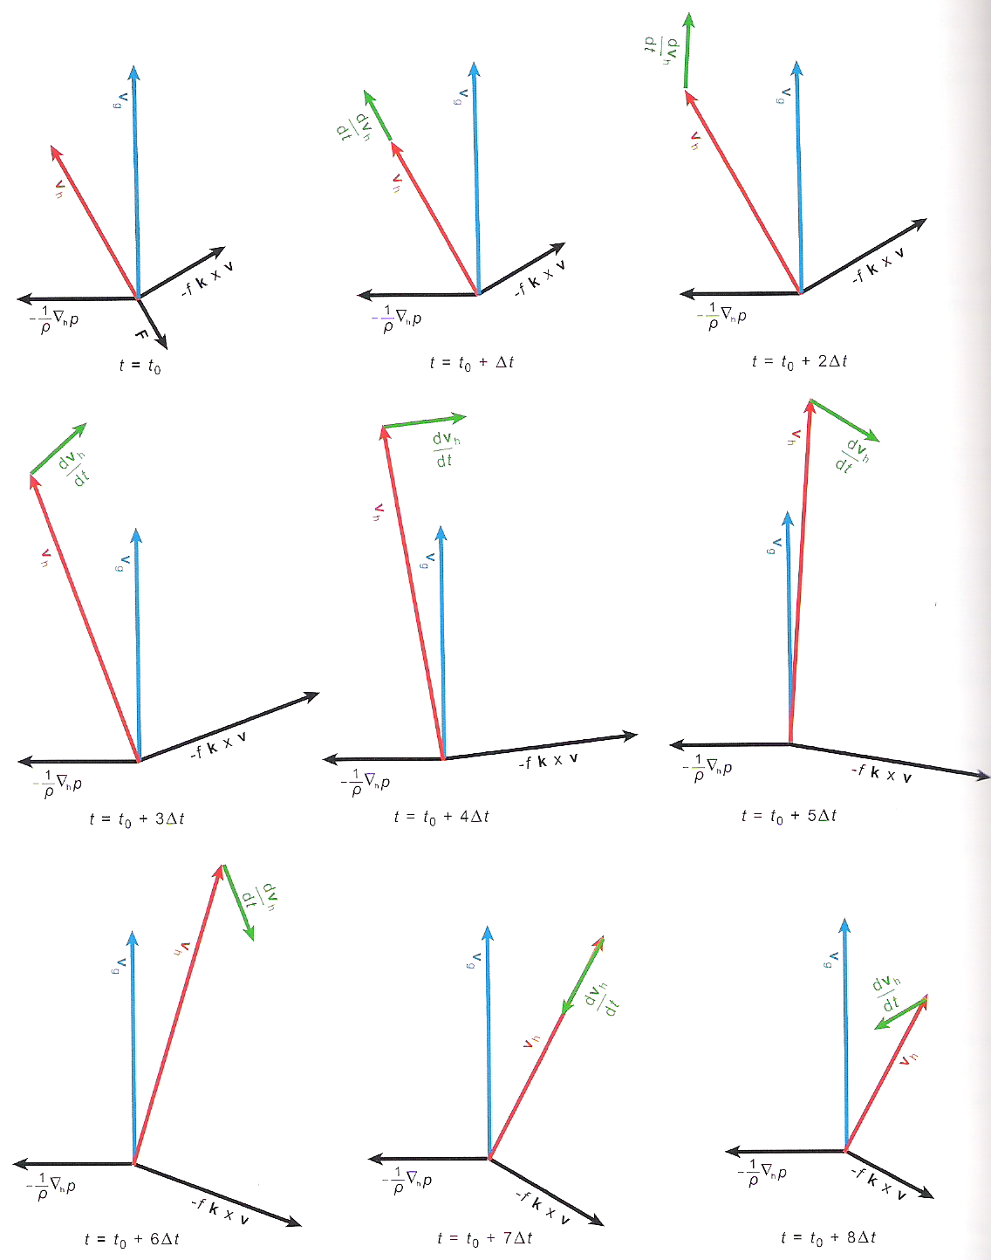
Inertial Oscillations and Force Balances
Note that the horizontal pressure gradient force and geostrophic wind are both assumed constant.
The termination of friction after the first panel disrupts balance. This accelerates the horizontal wind.
In turn, this increases the Coriolis force, which results in a clockwise-turning acceleration vector (which points in the direction of the force imbalance, with proportional magnitude).
Reproduced from Mesoscale Meteorology in Mid-Latitudes, their Fig. 4.33.

Slide 13
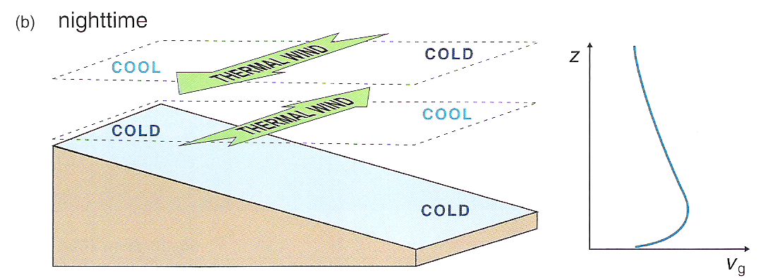
Sloping Terrain
Assumed: a purely meridional geostrophic wind with zonal horizontal geopotential height gradient.
Reproduced from Mesoscale Meteorology in Mid-Latitudes, their Fig. 4.36b.

Slide 14
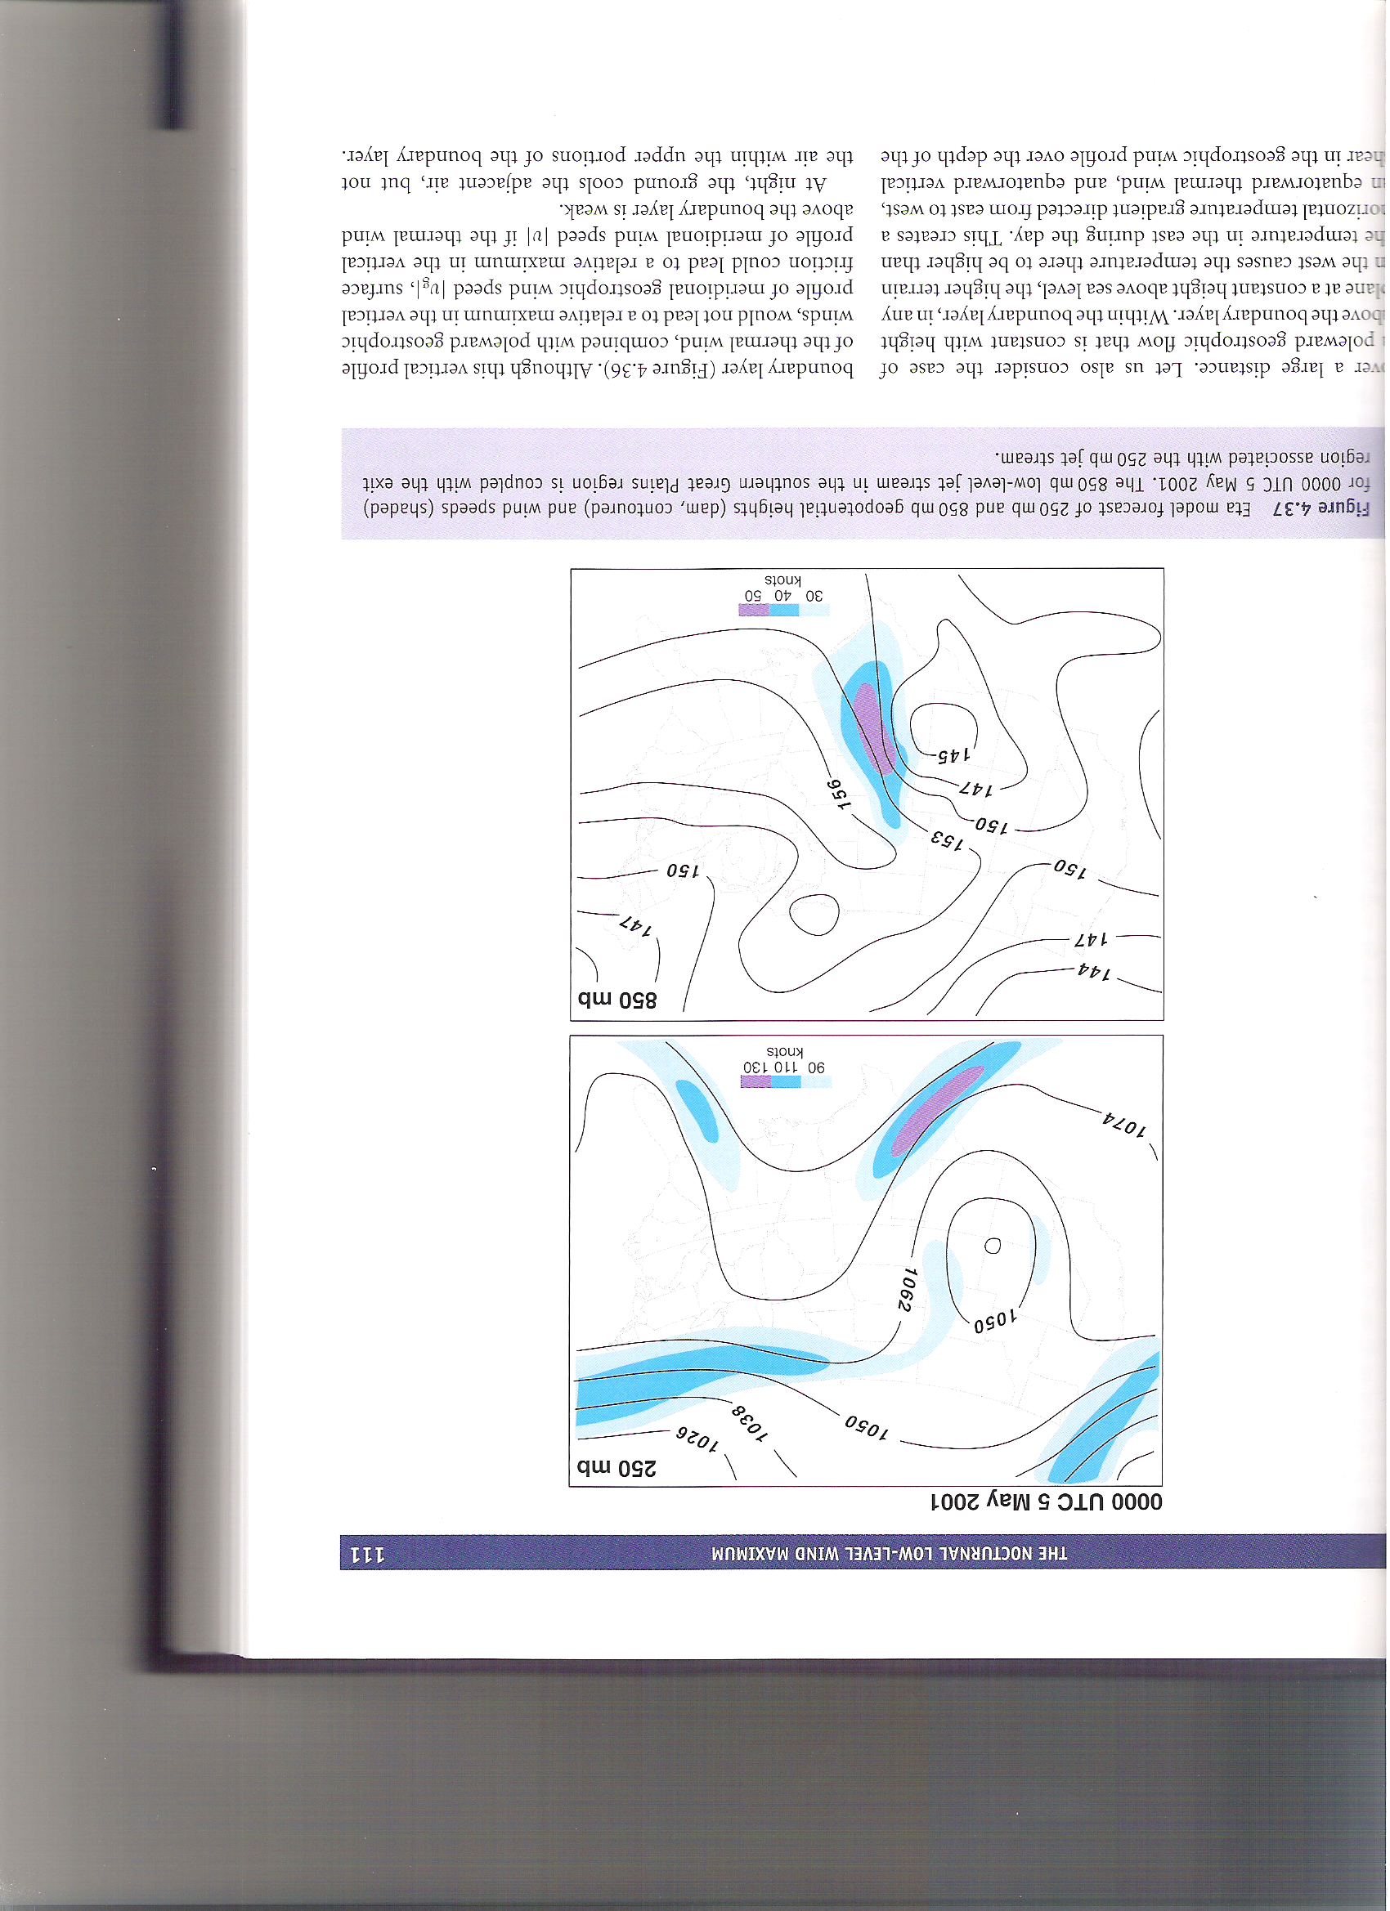
Upper-Level Forcing of Low-Level Jets
v_{ag} (250 hPa)
v_{ag} (850 hPa)
Reproduced from Mesoscale Meteorology in Mid-Latitudes, their Fig. 4.37.

